Slide 1


Slide 2

Realistic Future Service Provider Opportunities
Victor Pascual Avila
Independent
Technology, Innovation & Strategy Consultant Email
Twitter, etc

Slide 3


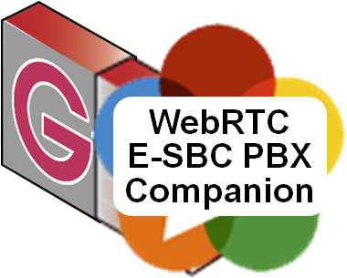
THE “WeBRTC-Ready” ACcess
Ingate’s SBCs do more than POTSoIP SIP. They were developed for standards-compliant end-to-end multimedia SIP connectivity everywhere.
WebRTC is just aligned – Ingate adds Q-TURN telepresence quality and the WebRTC & SIP PBX Companion for the enterprise UC “social network”.
Merged Intertex Data AB
and Ingate Systems AB
Karl Stahl
CEO/CTO
Ingate Systems
karl.stahl@intertex.se

Slide 4

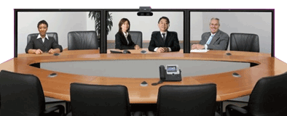
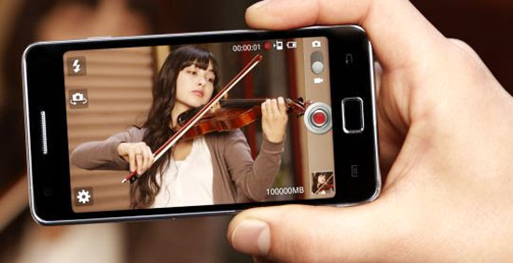


WebRTC – Available Everywhere
A Giant Step: From POTS to Telepresence
WebRTC has the potential of telepresence quality: Opus HiFi sound and VP8 / H.264 HD video
Last 50 years has brought mobility and SMS text to telephony, but not improved telephony itself.
WebRTC may finally bring global person-to-person communication beyond POTS (telephony wideband codecs, 7 kHz, are still not AM radio quality…)
Does that bring revenue to service provides? To carriers or to which service providers?
Who earned from Skype?
Pre- AM Radio 3.5 kHz ➔ 20 kHz audio and 3.5 Mbps video

Slide 5
Telephony Value? WebRTC Accelerating the Change to Broadband Value…
Mobile phones took over fixed POTS-type telephony. Fixed telephony became UC.
We use fixed broadband with high bandwidth at low cost (even though access is wireless)
The iPhone made Internet access “OTT” more important than telephony for the mobile phone.
WebRTC will not reverse that – It will rather accelerate the trend of making the Internet/ OTT broadband more valuable than telephony.
General Trend
Telephony is now flatrate (included in base fee)
Broadband is unlimited or data amount charged
Carriers Provide the Pipe
Services are from others and often free
The Access is the Service

Slide 6
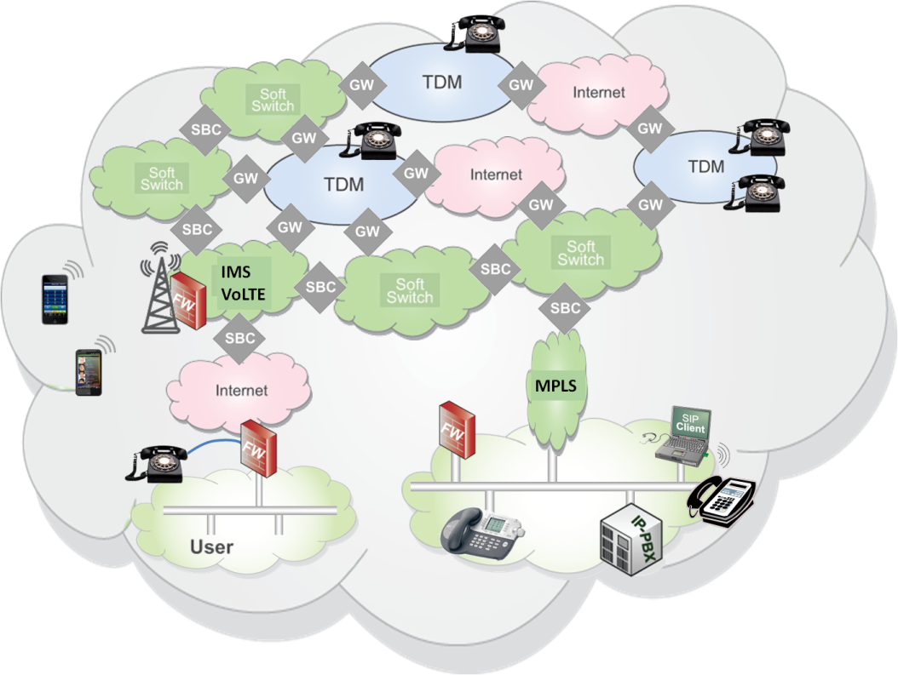
Network Service Providers, Carriers, Have Cost For the Provided Bandwidth
With WebRTC We Need Quality on Data-Crowded Internet/OTT Access
Customer appreciation was for:
  Fast surfing: Moderate bandwidth, quick response (high value/bit)
  Movies, TV, YouTube (streaming video): Huge bandwidth, delay insensitive (low value/bit)
  And now with WebRTC: Quality bandwidth, low delay (high value/bit)
Carrier cost is for bandwidth & usage
The “Telephone Network” (PSTN, VoIP, IMS, VoLTE… )
Few bits transferred
Still high carrier cost

Slide 7
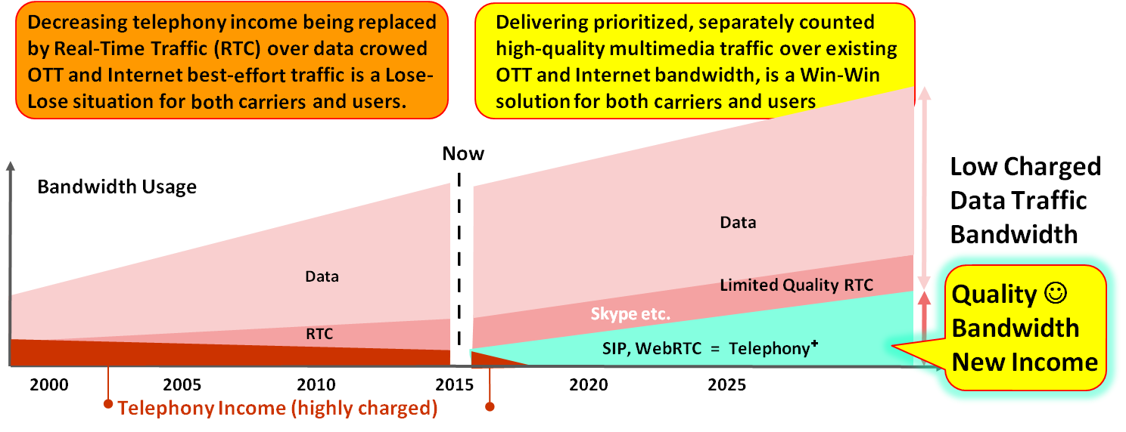
Who Doesn’t Want a “WebRTC-Ready” Broadband Access? It’s Win-Win!
It is NOT “Just About Bandwidth” with today’s data-crowded networks
Prioritized bandwidth brings value to customers and network providers
The Killer App Is Better Broadband
Can be either flat rate or session based

Slide 8
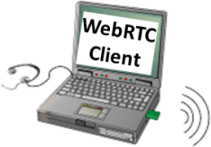





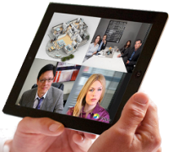








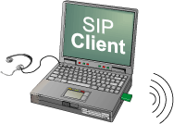


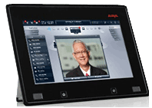
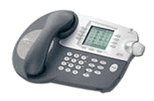

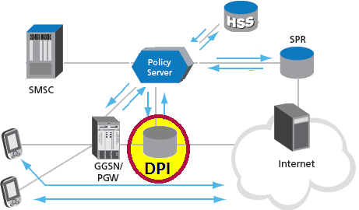
Broadband Access Routers Need to Add Quality and Accounting
The networks already have QoS mechanisms. Access devices need to classify, prioritize and count usage.
WebRTC requires TURN servers for ICE based NAT/firewall traversal.
SIP requires SBCs for the same.
All can be included in the “WebRTC-Ready” or “RTC-Ready” Access!
SIP Connect 1.1
Internet+

Slide 9
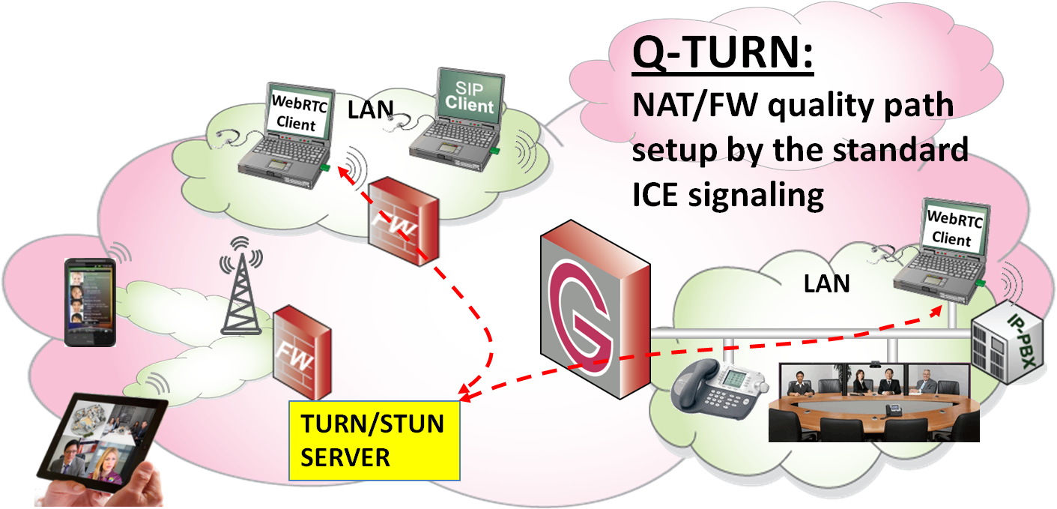
A Novel View on ICE – Q-TURN
TURN/STUN required for WebRTC (like SBCs for SIP)
Knock knock; Give my media a Quality Pipe
Regard ICE as a request for real-time traffic through the access router/firewall. Interpret the STUN & TURN signals in the firewall.
Have the STUN/TURN server functionality IN the access router/firewall and setup the media flows under control.
Security is back in the right place - The firewall is in charge of what is traversing
Enterprise firewall can still be restrictive
Q-TURN
Q-TURN Enables QoS and More:
Prioritization and Traffic Shaping
Diffserv or RVSP QoS over the net
Authentication (in STUN and TURN)
Accounting

Slide 10
SIP (Telephony) Can Also Go Internet/OTT
WebRTC starts there ➔ Internet⁺
Traffic will fade from the specific telephone network anyway, when the always logged-in Facebook, Twitter, Gmail etc. can terminate phone calls in the browser. (Compare how Apple took the SMSs.)
SIP can also be end-to-end (also enabling global UC).
WebRTC Prescribes ICE for NAT/firewall traversal, which uses STUN & TURN, negotiated in SDP. SIP most often uses E-SBCs.
Without telephony peering, incompatibilities and POTS limitations vanish. Standards-based real-time communications allow for beyond POTS services.
SIP Connect 1.1
Internet+

Slide 11
The Killer Application is:
Better Broadband Available Everywhere
Meet Ingate at Display Table #4

Slide 12
Questions
Will there be better price plans, even without WebRTC? Today – in addition to telephony – the more valuable/costly broadband usage is only measured in various amounts of data transferred (not considering quality or customer value).
WebRTC has no addresses, but will the always-logged-in Giants – Facebook, Twitter, Gmail – break the telco monopoly on phone numbers? They have knowledge of your mobile numbers and can be seen as giant “SIP registrars & ENUM databases”. They can offer to terminate the phone calls in the browser. (Compare how iPhone takes the SMSs.)

Slide 13
Questions
We have heard that pipe delivery is not “just all about bandwidth”. That is quite different in different camps. The telephony world is often concerned about the 3.5 kHz POTS voice quality over IP, while the network QoS for the HiFi, HD-capable WebRTC is not considered in other camps. Comments?
Is video conferencing with Telepresence quality really disruptive? Will we travel less? Will interviews just be electronic? Will conferences like this be over the net? …

